Slide 1
USE CASE DIAGRAM
Scenario Based

Slide 2
Requirements Specification vs Analysis Model
Both focus on the requirements from the user’s view of the system
The requirements specification uses natural language (derived from the problem statement)
The analysis model uses a formal or semi-formal notation (we use UML)

Slide 3

USE CASE DIAGRAM
The use case represents the different ways in which a system can be used by the users
A use case describes interactions of actors with the target system to perform a function.
The use case model can be documented by drawing a use case diagram and writing an accompanying text elaborating the drawing (use case specification)

Slide 4
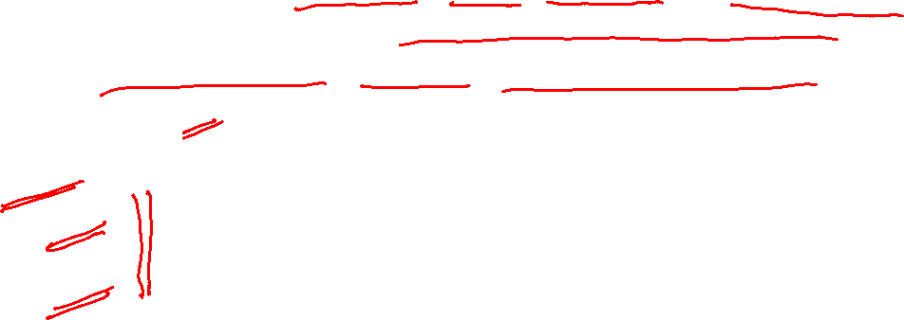
Use Case Diagrams
Use case diagrams are used to visualize, specify, construct, and document the (intended) behavior of the system, during requirements capture and analysis.
Provide a way for developers, domain experts and end-users to Communicate.
Serve as basis for testing.
The use case diagram consists of
Actor
Use cases
Relationships

Slide 5
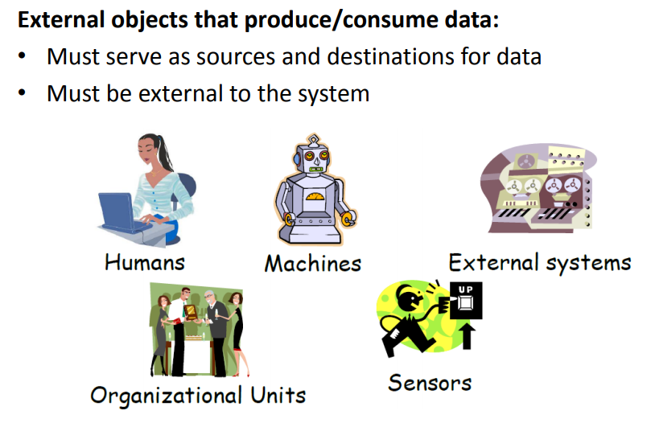
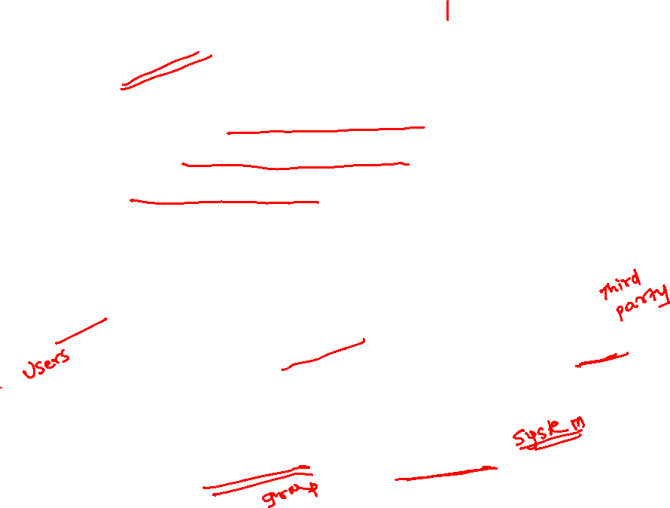
Actors

Slide 6
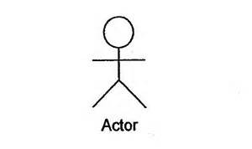
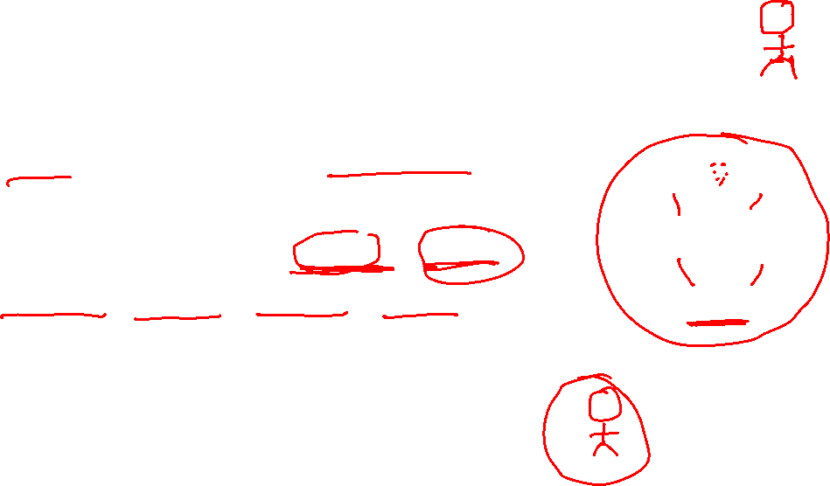
ACTOR
Each Actor must be linked to a use case
Represented by stick figure
Labelled using a descriptive noun or phrase
Eg: Librarian, Doctor, Student, Customer

Slide 7
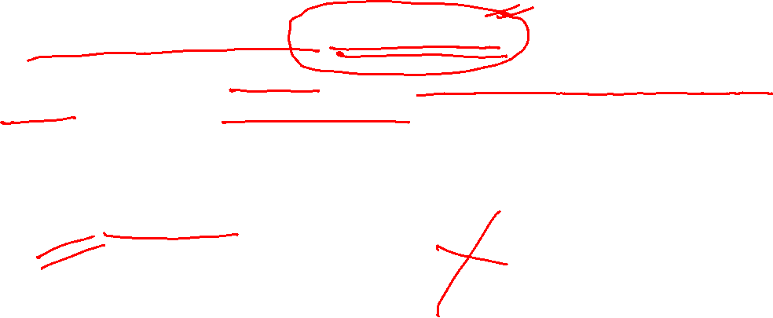
USE CASE
Labelled using a descriptive verb-noun phrase
Represented using an ellipse with name of the use case written inside the ellipse or written below the ellipse
Borrow Books
Borrow Books

Slide 8
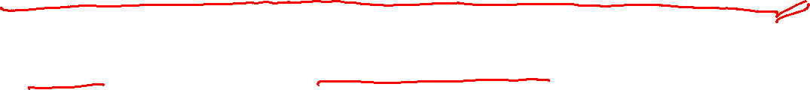
Consider the following scenario:
“A patient calls the clinic to make an appointment for a yearly checkup”
A patient calls the clinic to make an appointment for a yearly checkup.
Use case

Slide 9

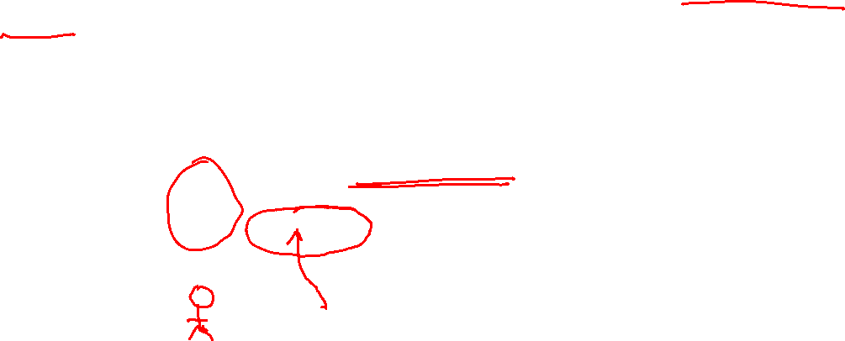
The picture below is a Make Appointment use case for the medical clinic.
The actor is a Patient. The connection between actor and use case is a communication association (or communication for short).

Slide 10
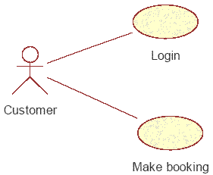

RELATIONSHIPS
Represents communication between actor and use case
Depicted by a line connecting actor and use case

Slide 11
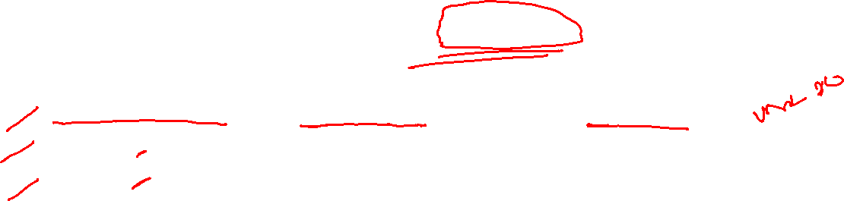
Other Types of Relationships for Use Cases
Generalization (in old version 1.0 but removed from 2.0)
Include
Extend

Slide 12
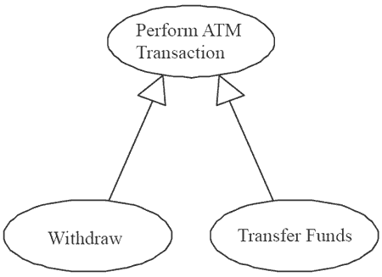
Generalization Relationship
refers to the relationship which can exist between two use cases and which shows that one use case (child) inherits the structure, behavior, and relationships of another actor (parent).
The child use case is also referred to the more specialized use case while the parent is also referred to as the more abstract use case of the relationship.
Generalization is possible within use cases and also between actors
Represented by a line and a hollow arrow
Generalization between use cases:

Slide 13
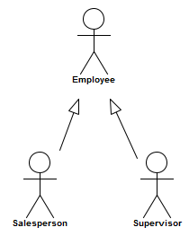
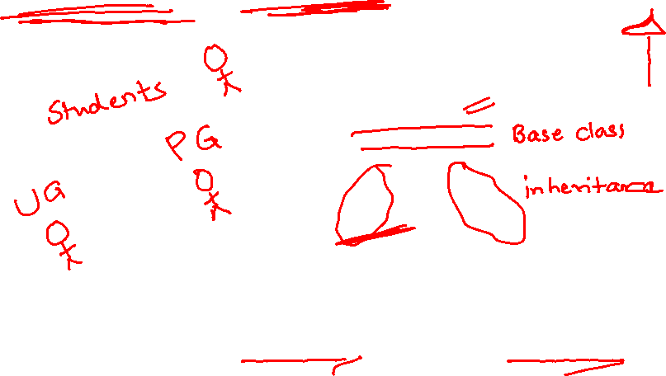
Generalization between actors

Slide 14

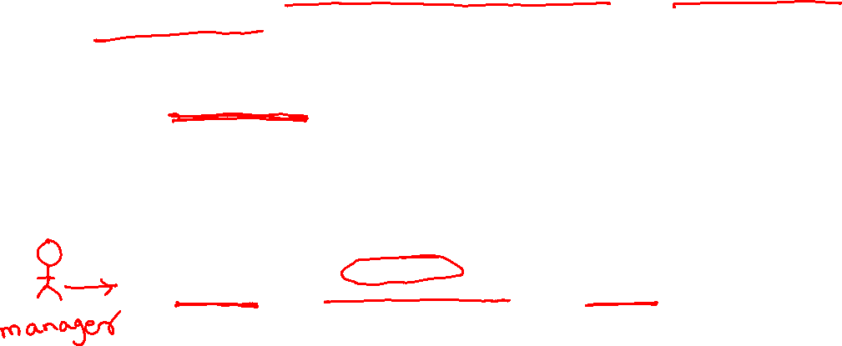
Include Relationship
Represents the inclusion of the functionality of one use case within another
Arrow is drawn from the base use case to the used use case
Write << include >> above arrowhead line
Send mail
<<include>>
Login

Slide 15
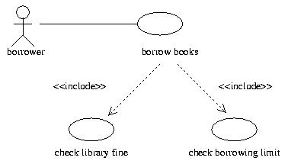


Slide 16
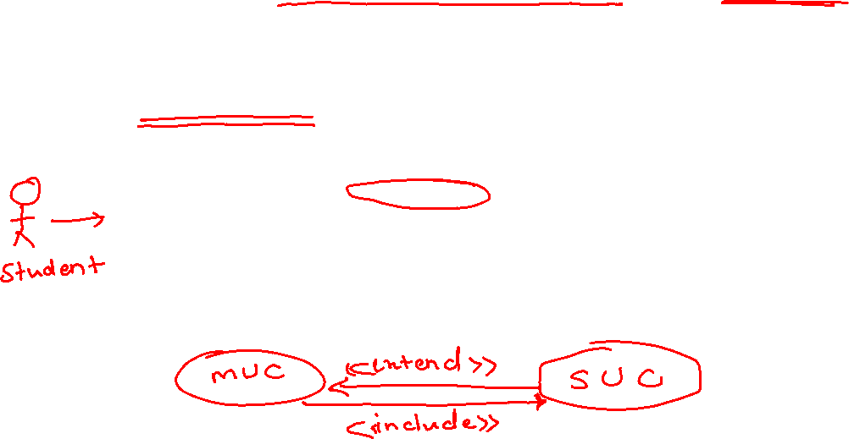
Extend relationship
Represents the extension of the use case to include optional functionality
Arrow is drawn from the extension use case to the base use case
Write << extend >> above arrowhead line
Register
<<extend>>
Get help on registration

Slide 17
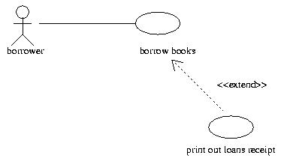
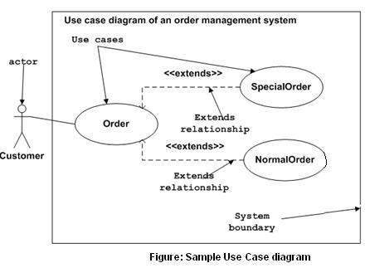


Slide 18
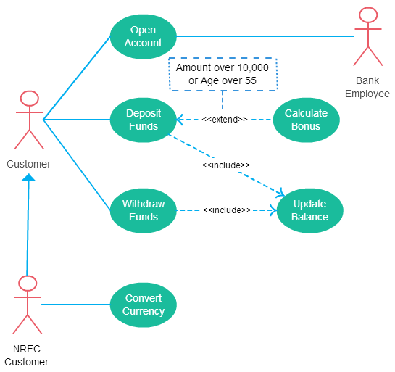
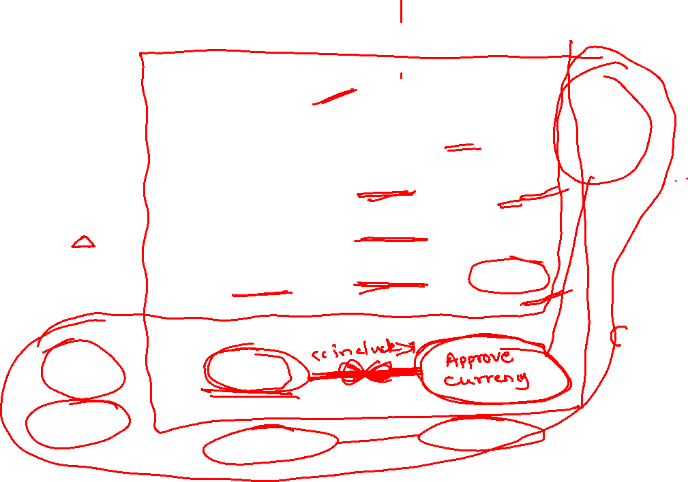

Slide 19
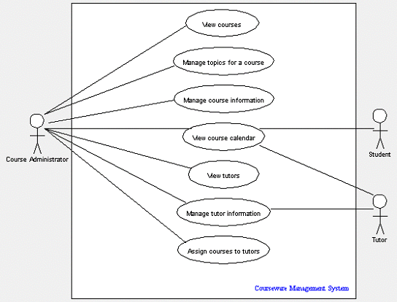
Use case diagram example

Slide 20

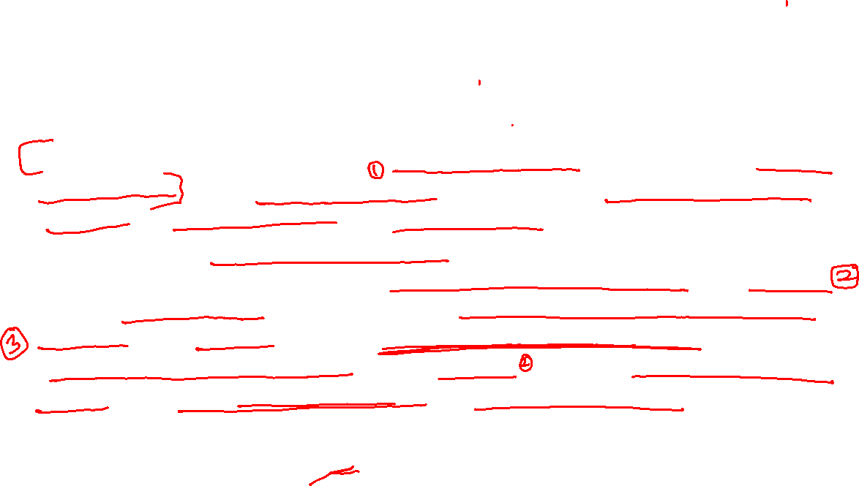
Problem Statement 1
The System is intended for faculty members to conduct online examination. Every registered faculty member can login to the system, create test, set the questions, set the mode for each test etc. Faculty member also decides which groups of students have to take a particular test and accordingly creates group of students. The system should send mail to the students inviting them to take the test. Students can login using the verification number received and then answer the test questions. The System should evaluate student answers and send the result via mail or can print the result.

Slide 21

Problem Statement 1
The System is basically intended for faculty members to conduct online examination. Every registered faculty member can login to the system, create test, set the questions, set the mode for each test etc. Faculty member also decides which groups of students have to take a particular test and accordingly creates group of students. The system should send mail to the students inviting them to take the test. Students can login using the verification number received and then answer the test questions. The System should evaluate student answers with that specified by faculty and send the result via mail.

Slide 22
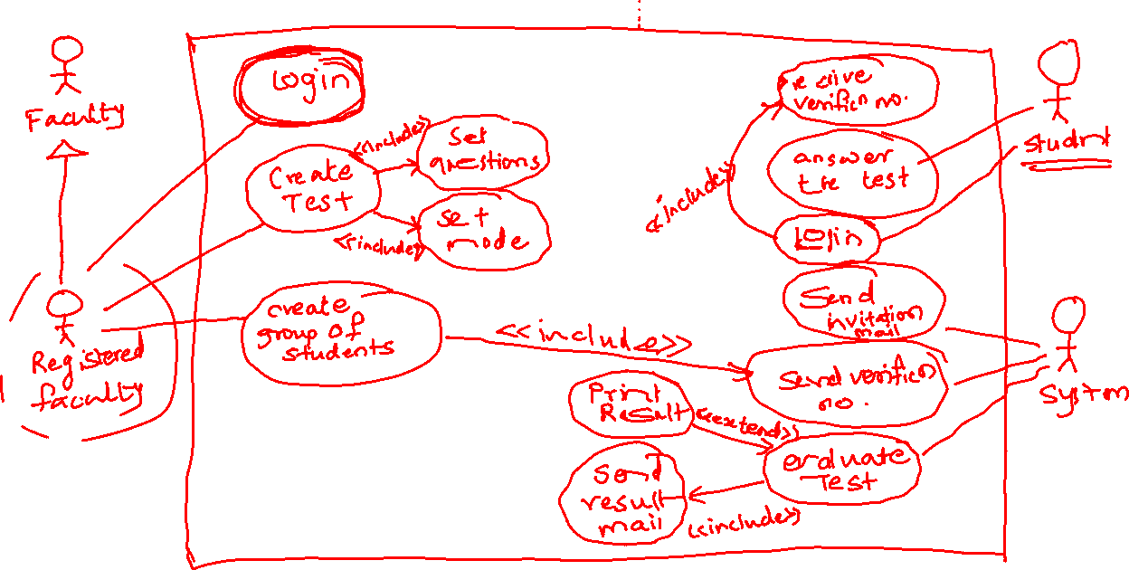

Slide 23
Problem Statement 2
An auto rental company wants to develop an automated system that would handle car reservations, customer billing, and car auctions. Usually a customer reserves a car, picks it up, and then returns it after a certain period of time. At the time of pick up, the customer has the option to buy or waive collision insurance on the car. When the car is returned, the customer receives a bill and pays the specified amount. In addition to renting out cars, every six months or so, the auto rental company auctions the cars that have accumulated over 20,000 miles.

Slide 25
Problem Statement 3
Draw the use-case diagram for Hotel Information System. There are two types of customers: Tour-group customers and Individual customers. Both can book, cancel, check-in and check-out of a room by Phone or via the Internet. There are booking process clerk and reception staff who manage it. A customer can pay his bill by credit card or by cash. After frequent booking of hotel more than 5 times, customer can go for booking of special package of stay for 6th time. Clerk also maintains the resources available in the hotel and reception staff takes care of feedback collection from the customer.

Slide 26
Problem Statement 4
A student may register for classes during a specified registration period. To register, a student must see their advisor. The advisor must approve each course that the student has selected. The advisor will use the registration system to determine if the student has met the course prerequisites, is in good academic standings and is eligible to register. If the advisor approves the courses, the advisor enters the student's college id into the course registration system. The course registration number for each course is entered. The course description, course number and section for those courses will automatically display. The system will check for schedule conflicts before saving the registrations. A bill for the courses will print in the financial administrator’s office. The student should proceed to pick it up. Faculty can use the registration system to check enrollments in their classes, get a class list, check a student's transcript, look up a student's phone number and other such student information. The registrar can use the registration system to enter new classes for an upcoming semester, cancel a class, and check conflicts in classroom/faculty assignments. Admissions use the registration system to add new students. Enrollment services use the registration system to report on retention, update student information, and check fulfillment of graduation requirements for those students planning to graduate.

Slide 27
Types of Requirements
Functional requirements
Describe the interactions between the system and its environment independent from the implementation
“An operator must be able to define a new game. “
Nonfunctional requirements
Aspects not directly related to functional behavior.
“The response time must be less than 1 second”
Constraints
Imposed by the client or the environment
“The implementation language must be Java “
Called “Pseudo requirements” in the text book.
Notes:
Constraints (“Pseudo requirements”):
Imposed by the client or the environment in which the system operates
The implementation language must be Java
ARENA must be able to dynamically interface to existing games provided by other game developers
Functional requirements:
Describe the interactions between the system and its environment independent from implementation
“An operator should be able to define a new game. “
Nonfunctional requirements:
User visible aspects of the system not directly related to functional behavior.
“The response time must be less than 1 second”
“The server must be available 24 hours a day”
Constraints (“Pseudo requirements”):
Imposed by the client or the environment in which the system operates
“The implementation language must be Java “

Slide 28
Functional vs. Nonfunctional Requirements
Functional Requirements
Describe user tasks that the system needs to support
Phrased as actions
“Advertise a new league”
“Schedule tournament”
“Notify an interest group”
Nonfunctional Requirements
Describe properties of the system or the domain
Phrased as constraints or negative assertions
“All user inputs should be acknowledged within 1 second”
“A system crash should not result in data loss”.
Notes:
Note: Many nonfunctional requirements can be rephrased as functional requirements.
Example: “All actions are undoable” can be rephrased by adding a functional requirement for each
undoable action.
For example, the use case “Advertise new league” yields a new use case “Cancel advertised league” to
undo the effects of the first one.

Slide 29
Types of Nonfunctional Requirements
Usability
Reliability
Robustness
Safety
Performance
Response time
Scalability
Throughput
Availability
Supportability
Adaptability
Maintainability
Implementation
Interface
Operation
Packaging
Legal
Licensing (GPL, LGPL)
Certification
Regulation
Constraints or Pseudo requirements
Quality requirements

Slide 30
Nonfunctional Requirements: Examples
“Spectators must be able to watch a match without prior registration and without prior knowledge of the match.”
Usability Requirement
“The system must support 10 parallel tournaments”
Performance Requirement
“The operator must be able to add new games without modifications to the existing system.”
Supportability Requirement

Slide 31
USE CASE SPECIFICATION (detailed version of a use case)

Slide 32
Use Case Specification
Brief Description - (about the use case)
Actors – list out the actors involved
Preconditions - A textual description that defines any constraints on the system at the time the use case may start.
Basic flow of events - describes what "normally" happens when the use case is performed.
Alternative flows - covers behavior of an optional or exceptional character relative to normal behavior, and also variations of the normal behavior. Think of the alternate flows of events as "detours" from the basic flow of events.
Postconditions - A textual description that defines any constraints on the system at the time the use case will terminate.

Slide 33
Use-Case Specification: Withdraw Cash
1. Brief Description
This use case describes how a Bank Customer uses an ATM to withdraw money from a bank account.
2. Actors
Customer
Bank
3. Preconditions:
The bank Customer must possess a bank card.
The network connection to the Bank System must be active.
The system must have at least some cash that can be dispensed.
The cash withdrawal service option must be available.

Slide 34
4. Basic Flow of Events
4.1 Insert Card
The use case begins when the actor Customer inserts his/her bank card into the card reader on the ATM.
The system allocates an ATM session identifier to enable errors to be tracked and synchronized between the ATM and the Bank System.
4.2 Read Card
The system reads the bank card information from the card.
4.3 Authenticate Customer
Authenticate the use of the bank card by the individual using the machine
4.4 Select Withdrawal
The system displays the service options that are currently available on the machine.
The Customer selects to withdraw cash.
4.5 Select Amount
The system prompts for the amount to be withdrawn by displaying the list of standard withdrawal amounts.
The Customer selects an amount to be withdrawn.
4.6 Confirm Withdrawal
Customer gives conformation to withdraw cash
4.7 Eject Card
The system ejects the Customer’s bank card.
The Customer takes the bank card from the machine.
4.8 Dispense Cash
The system dispenses the requested amount of cash to the Customer.
The system records a transaction log entry for the withdrawal.
4.9 Use Case Ends
The use case ends.

Slide 35
5.Alternative Flows
5.1 Invalid User
5.2 Amount Exceeds Withdrawal limit
5.3 Insufficient cash
5.4 Money not removed

Slide 36
6. Postconditions
The ATM has returned the card and dispensed the cash to the Customer and the withdrawal is registered on the Customer’s account.
The ATM has returned the card to the Customer and no withdrawal is registered on the Customer’s account.
The ATM has returned the card but has not supplied the amount of cash registered as withdrawn from the Customer’s account. The discrepancy is registered in the ATM’s log.
The ATM has kept the card, no withdrawal has registered on the Customer’s account and the Customer has been notified where to contact for more information.

Slide 37
Write a use case specification for
book ticket use case in a railway ticket booking system.
Order item use case in an online shopping website.

Slide 38
Millennium Travel Corporation (MTC) travel agency plans to become a market leader by augmenting its human travel agents with an automated travel agent system for processing flight reservations. The automated travel agent will intermediate between travelers and the MTC corporate computing system, which interfaces with commercial airline reservation services. Like a human travel agent, it will assist travelers in booking, changing, and canceling flight reservations. If, for any reason, a traveler making a flight reservation travel request prefers human assistance, she will have the option to interact directly with a human travel agent.
The MTC automated travel agent system will process a wide range of flight reservation service requests. These include but are not limited to: inquiring about flights and airfares, making, changing, and canceling traveler profiles and accounts, booking, changing, confirming, and canceling flight reservations, generating travel itineraries.
A user with a valid system account and a valid travel account logs in to the system, requests to book a flight reservation, selects a flight, selects a payment method, and specifies delivery services for the flight tickets and travel itineraries.
The travel agent system must be capable of providing fast, accurate, and courteous ("user friendly") services for all requests supported. The system must be able to answer inquiries about flights and fares, generate, modify, and cancel traveler profiles and travel accounts, make, change, complete, and cancel reservations, obtain payment method and verify traveler credit line, generate travel itineraries and arrange for delivery of flight tickets and flight itineraries.

